Slide 1

Promise:
To release a product that promotes robotics to K-12 children in a fun and interactive way
Credibility:
Designed and tested with safety in mind. Design also confirmed with various campus students to ensure satisfaction
Differentiator:
Our product promotes kids learning through a fun method at an affordable price point

Slide 2
Price
Risk
Effort
The price of the product has not been decided however we want to make it affordable to public school systems or individual groups
Risk of product could be malfunction or possible exposed electronic components that children may put in their mouth We put a large amount of effort into the design to try making it appeal to the target audience while still the ability to learn from it

Slide 3

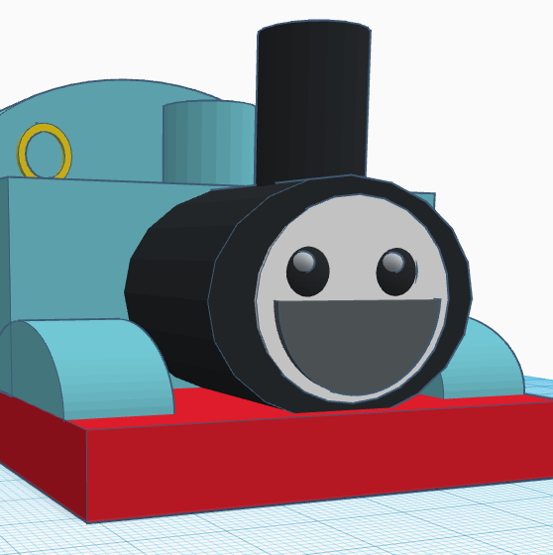
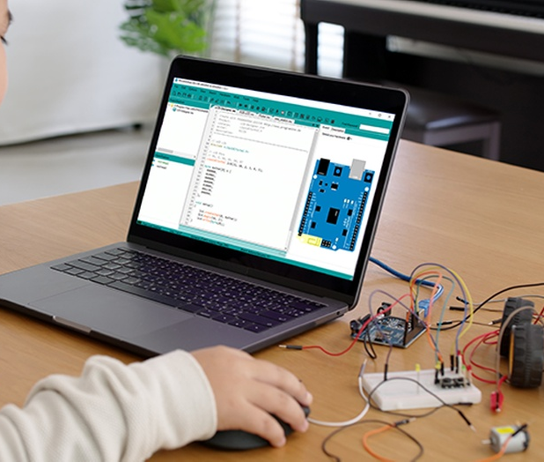
Fun and Interactive Design!
Coding capabilities for enhanced learning
All at an affordable price

